Slide 1
NLP Project Ideas
Sukkur IBA Chatbot
Text Modification Application for Student Feedback
By: Nimra Mughal

Slide 2
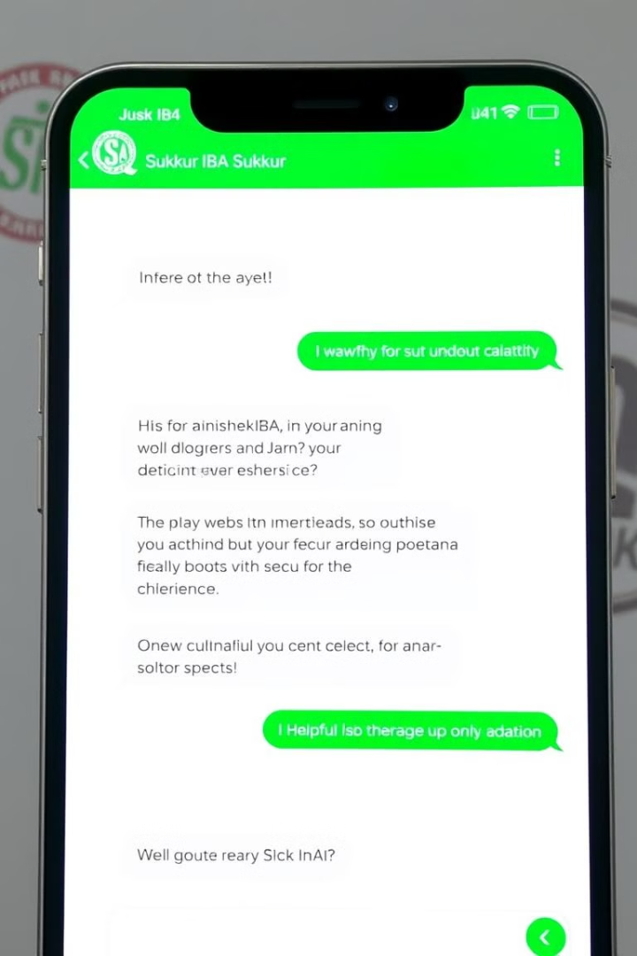
Sukkur IBA Chatbot Proposal

Slide 3
Sukkur IBA Chatbot: RAG-powered
Objective
Functionality
Develop an intelligent chatbot for Sukkur IBA University that leverages Retrieval Augmented Generation (RAG) to provide accurate and context-aware responses to user queries.
The chatbot will scrape relevant data from the Sukkur IBA website based on nouns extracted from user queries, store this data in ChromaDB, and use it to generate tailored responses.

Slide 4
Key Components
1
Web Scraping & Context Extraction
2
ChromaDB for Semantic Search
Extract key nouns from user queries (e.g., “admission requirements”) using NLP. Dynamically scrape relevant data from the Sukkur IBA website based on these extracted nouns.
Convert scraped data into semantic vectors and store them in ChromaDB for fast retrieval. ChromaDB enables efficient search based on semantic similarity, ensuring relevant results.
3
Retrieval Augmented Generation (RAG)
4
User Interface
Retrieve contextually relevant content from ChromaDB based on query similarity. Use the RAG model to generate a coherent response by combining retrieved content with the original query.
Provide a conversational UI for seamless interaction with students, staff, and visitors. Design an intuitive and user-friendly interface that facilitates natural language interaction.

Slide 5
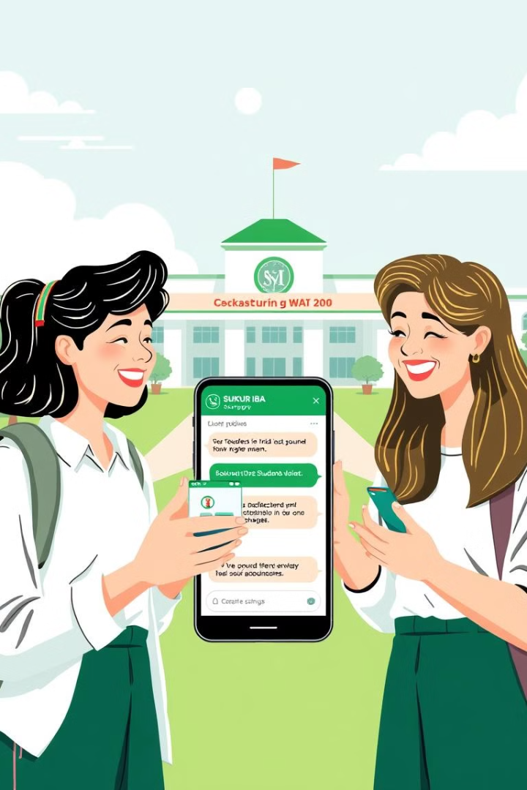
Benefits of a RAG-powered Chatbot
Context-Aware Responses
Combines retrieval and generation for more accurate and relevant answers, providing users with tailored information.
Efficient Information Retrieval
ChromaDB ensures fast and scalable data access, enabling quick and efficient retrieval of relevant information from the Sukkur IBA website.
Real-Time Adaptation
Easy to update with new website content, keeping responses current and ensuring users have access to the latest information.
Enhanced User Experience
Instant, personalized, and accurate answers improve user interaction, providing a seamless and efficient experience for all stakeholders.

Slide 6






Technical Stack for Sukkur IBA Chatbot
Python
NLP
ChromaDB
RAG Model
Python will be the primary programming language for web scraping, NLP tasks, and backend development.
SpaCy and BERT will be used for natural language processing, specifically for noun extraction and understanding user queries.
ChromaDB will serve as the database for storing and retrieving semantic vectors of scraped data, ensuring efficient semantic search.
A pre-trained Retrieval Augmented Generation model will be employed for generating coherent responses based on retrieved context and user queries.
Frontend: React
Backend: Flask
React will be used for building the interactive chatbot interface, providing a user-friendly and responsive experience.
Flask will serve as the backend framework for API development and managing communication between the chatbot frontend and backend systems.

Slide 7

Text Modification Application for Student Feedback
Develop an application that modifies student feedback while preserving its sentiment and key aspects. The system will perform aspect-based sentiment analysis to identify and analyze feedback aspects (e.g., teaching quality, facilities) and rephrase the feedback while maintaining the original sentiment.

Slide 8
Key Components of the Application
Aspect-Based Sentiment Analysis (ABSA)
Text Modification Engine
The application will utilize ABSA to extract and analyze different aspects of student feedback, such as teaching quality, campus environment, or administrative processes. For each aspect, the sentiment will be identified (positive, negative, or neutral).
A sophisticated text modification engine will rephrase or simplify feedback text while maintaining its original sentiment. This ensures that feedback remains clear, constructive, and actionable for faculty and administrators.

Slide 9

Benefits of the Text Modification Application
Improved Feedback Quality
The application ensures that feedback is constructive and actionable while preserving the original sentiment. This fosters a positive feedback culture within the university.
Data-Driven Insights
The application provides detailed insights into student satisfaction across various aspects, enabling universities to identify specific areas for improvement based on data analysis.
Time-Saving
The application automates feedback analysis and report generation, saving valuable time for faculty and administrative staff, allowing them to focus on other important tasks.
Actionable Reports
The application generates comprehensive reports that highlight key areas for improvement, enabling universities to make data-driven decisions that benefit students and faculty alike.

Slide 10

Conclusion: A Powerful Tool for Improvement
The Text Modification Application will revolutionize student feedback analysis within universities by providing a powerful tool that preserves sentiment, generates actionable insights, and empowers institutions to make data-driven improvements. This innovative application will foster a culture of continuous improvement and create a more positive and productive learning environment for all stakeholders.

